Slide 1

Broadly Neutralizing Antibody Delivered via Inhalation Protects Against SARS-CoV-2
A novel humanized antibody targets a conserved epitope on Spike protein, providing pan-neutralizing protection through inhalation-based delivery in non-human primates.

Slide 2
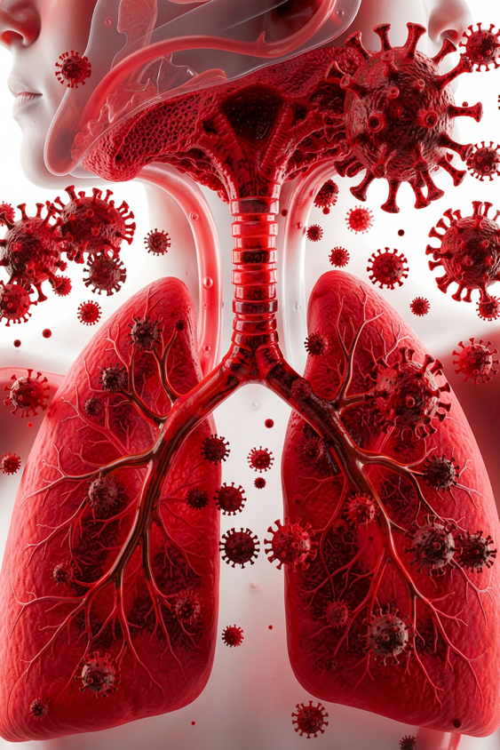
The Challenge
Variant Evolution
Delivery Limitations
Emerging variants of concern (VoCs) with mutations in Spike protein limit antibody efficacy
Systemic IV administration results in low antibody concentrations in respiratory mucosa
Access Barriers
Complex IV procedures limit broad clinical application and rapid treatment

Slide 3
Research Approach
Antibody Discovery
Delivery Method
Isolated antibodies from convalescent patients and immunized rabbits using HybriFree platform
Tested vibrating mesh nebulization for inhalation-based antibody delivery
Humanization
Validation
Developed ICO-hu104 antibody with >85% humanization score for therapeutic use
Evaluated in Syrian golden hamsters and non-human primate viral challenge studies

Slide 4
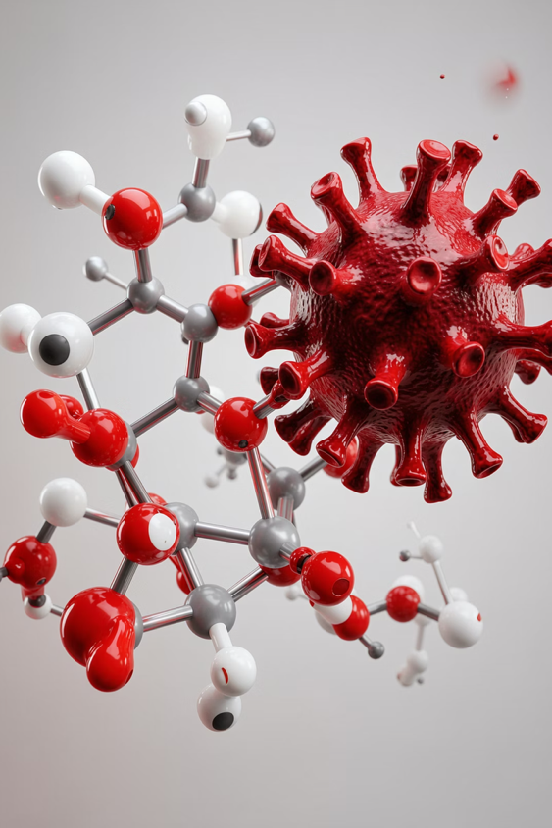
ICO-hu104: A Pan-Neutralizing Antibody
<1nM
6
IC50 Values
Variants Tested
Sub-nanomolar neutralization against all tested variants
Wuhan, Alpha, Beta, Delta, Omicron, Omicron BA.2
0.033nM
Best IC50
Alpha variant neutralization potency

Slide 5
Conserved Epitope Binding
Epitope Location
Conservation
Mechanism
Binds to exposed beta sheet in RBD, distal from common orthosteric sites
Zero mutations distinguish Wuhan from Omicron at binding site
Hydrogen-deuterium exchange mass spectrometry confirmed binding regions 433-443 and 497-502

Slide 6
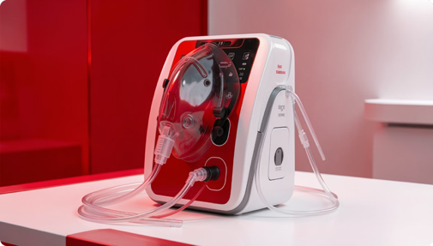
Nebulization Technology
Vibrating Mesh Device
Aeroneb Solo nebulizer adapted for macaque facemask delivery
Particle Size
MMAD approximately 4 µm ensures optimal respiratory tract deposition
Integrity Retention
Analytical size-exclusion chromatography confirmed antibody stability post-nebulization

Slide 7
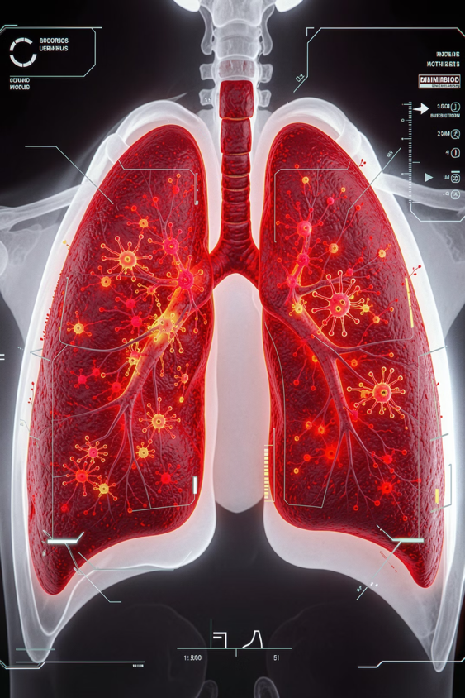



Antibody Distribution: Nebulization vs. IV
IV Route
100-fold higher systemic serum concentration
Nebulization
66-fold higher concentration in bronchoalveolar lavage
Target Tissue
Superior lung delivery where viral replication occurs

Slide 8



Viral Load Reduction in NHPs
2.7x
2.1x
10x
Nasopharyngeal gRNA
Nasopharyngeal gRNA
BAL gRNA
Reduction vs. controls (IV, p<0.01)
Reduction vs. controls (Neb, p<0.05)
Lower viral load at day 3 (both routes, p<0.01)
Significantly reduced viral loads in upper and lower respiratory tracts 2-4 days post-treatment

Slide 9
Key Findings
1
Pan-Neutralizing Activity
2
Superior Lung Delivery
ICO-hu104 maintains sub-nanomolar IC50 values against all VoCs including Omicron subvariants
Nebulization achieves 66-fold higher antibody concentrations in BAL vs. IV administration
3
Effective Viral Reduction
4
Clinical Potential
Significant decrease in viral loads in upper and lower respiratory tracts
Non-invasive inhalation approach enables rapid, accessible antibody delivery

Slide 10




Future Implications
Prophylaxis Option
Respiratory Pathogens
Rapid antibody delivery for vulnerable populations
Blueprint for targeting emerging respiratory viruses
Accessibility
Non-invasive method reduces clinical barriers

